Slide 1

Architecture of Internet of Things

Slide 2
What is Internet of Things (IOT)
Internet of Things (IoT) is the networking of physical objects that contain electronics embedded within their architecture to communicate and sense interactions amongst each other or to the external environment. In this article, we are going to discuss the architecture of the Internet of Things.
Internet of Things (IoT) technology has a wide range of applications and the use of the Internet of Things is growing so faster.
Example:
Smart Watches
Speedometer
Voice assistant (Alexa, Siri, etc)

Slide 3
Architecture of IoT
Sensing Layer
Network Layer
Data processing Layer
Application Layer

Slide 4
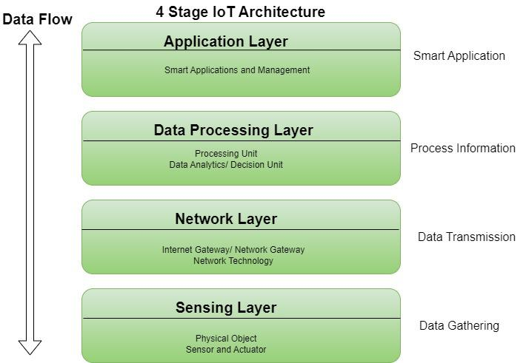

Slide 5
Sensing Layer
The sensing layer is the first layer of the Internet of Things architecture and is responsible for collecting data from different sources.
This layer includes sensors and actuators that are placed in the environment to gather information about temperature, humidity, light, sound, and other physical parameters.
Wired or wireless communication protocols connect these devices to the network layer.
First layer
Sensors
Actuators

Slide 6
Network Layer
The network layer of an IoT architecture is responsible for providing communication and connectivity between devices in the IoT system.
It includes protocols and technologies that enable devices to connect and communicate with each other and with the wider internet.
Examples of network technologies that are commonly used in IoT include WiFi, Bluetooth, Zigbee, and cellular networks such as 4G and 5G technology.
WIFI
Gateways
Routers

Slide 7
Data processing Layer
The data processing layer of IoT architecture refers to the software and hardware components that are responsible for collecting, analyzing, and interpreting data from IoT devices.
This layer is responsible for receiving raw data from the devices, processing it, and making it available for further analysis or action.
The data processing layer includes a variety of technologies and tools, such as data management systems, analytics platforms, and machine learning algorithms.
Collecting
Analyzing
Interpreting data

Slide 8
Application Layer
The application layer of IoT architecture is the topmost layer that interacts directly with the end-user.
It is responsible for providing user-friendly interfaces and functionalities that enable users to access and control IoT devices.
This layer includes various software and applications such as mobile apps, web portals, and other user interfaces that are designed to interact with the underlying IoT infrastructure.
Topmost layer
Data visualization
Users access and control

Slide 9
Advantages and Disadvantages of IoT
Advantages:
Execute multiple tasks at a time like a computer.
Easiest internet connectivity
Works on GUI (Graphical User Interface) mode because of HDMI port.
More reliable for software applications.
Disadvantages:
Security concerns and potential for hacking or data breaches.
Dependence on technology and potential for system failures.
Limited standardization and interoperability among devices.
Complexity and increased maintenance requirements

Slide 10
Thank you
Alston Alvares​
Roll no: 01
Khushi Tiwari
Roll no: 09

